Slide 1


GitHub Repository https://github.com/MLDB2020/MLDB

Slide 2
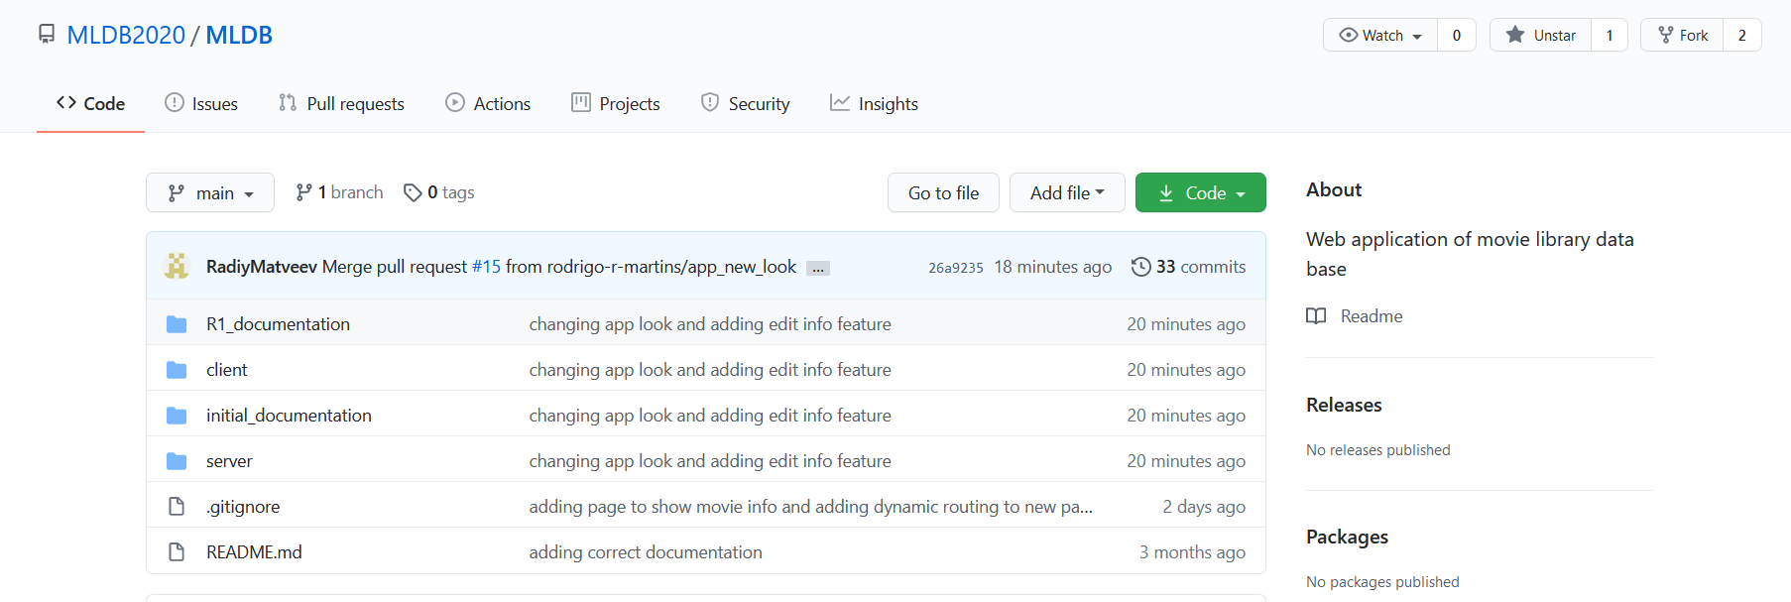
Root

Slide 3
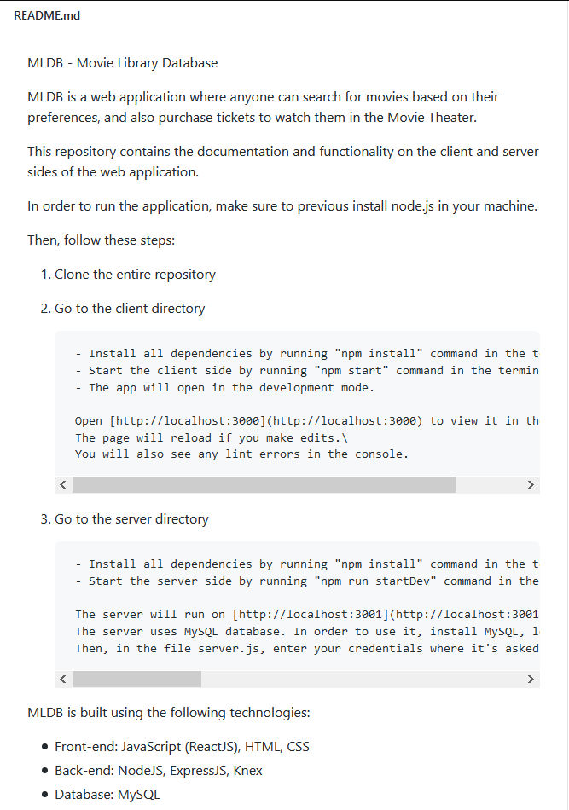
Readme (Build/Deployment Procedures)

Slide 4
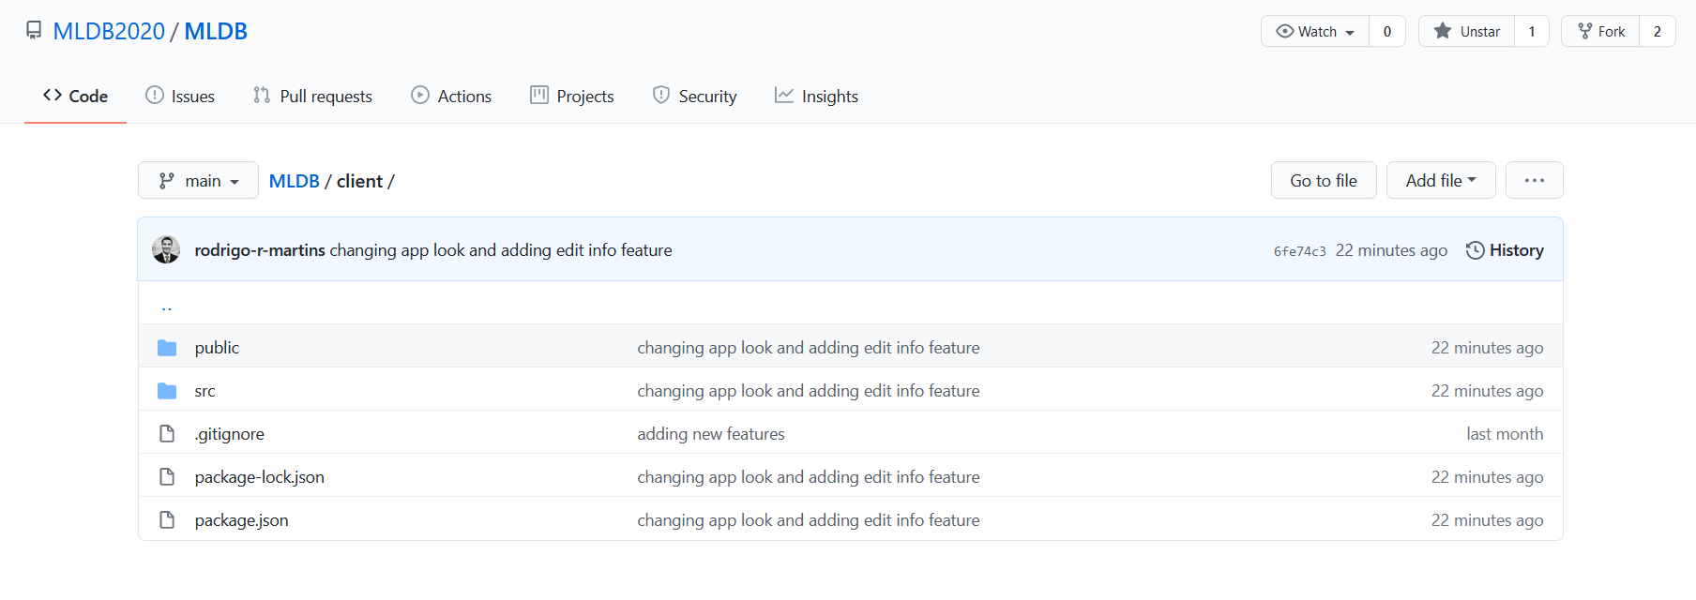
Client folder

Slide 5
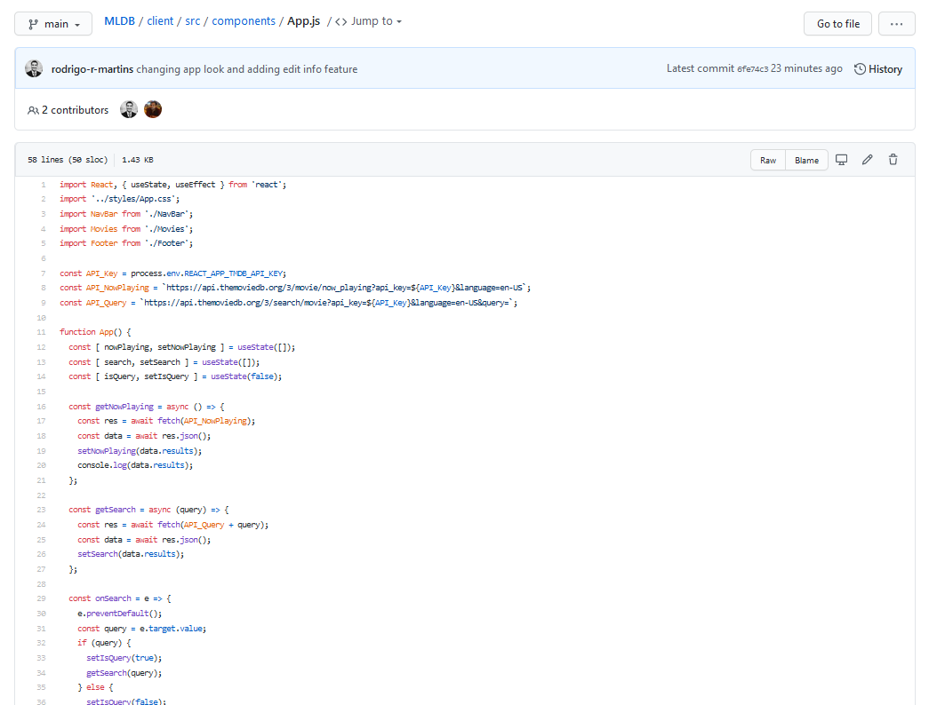
App Root Component – Code Overview

Slide 6
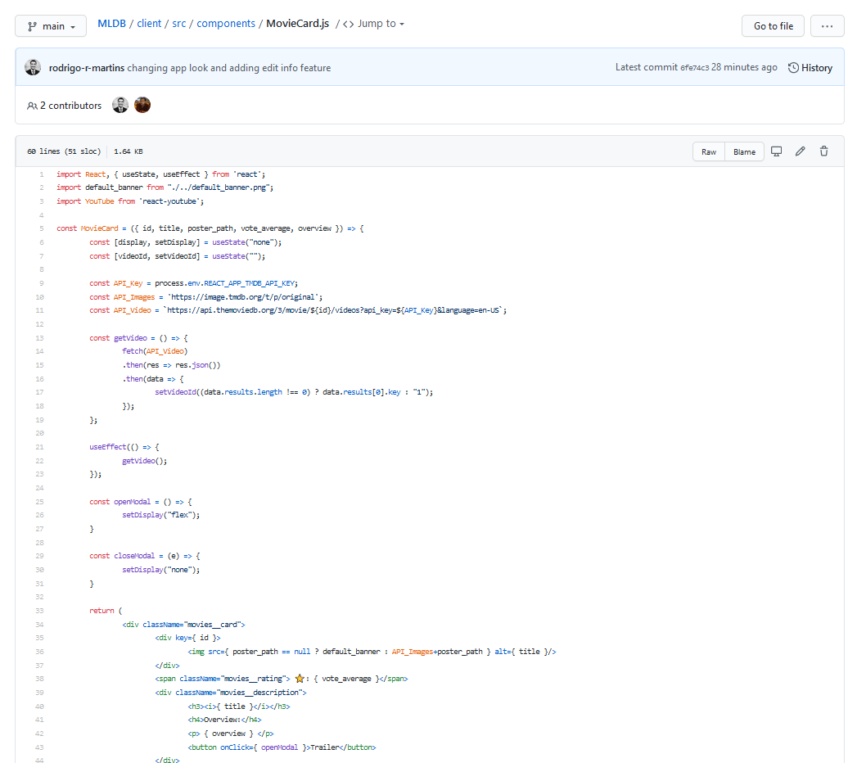
Movies Component

Slide 7
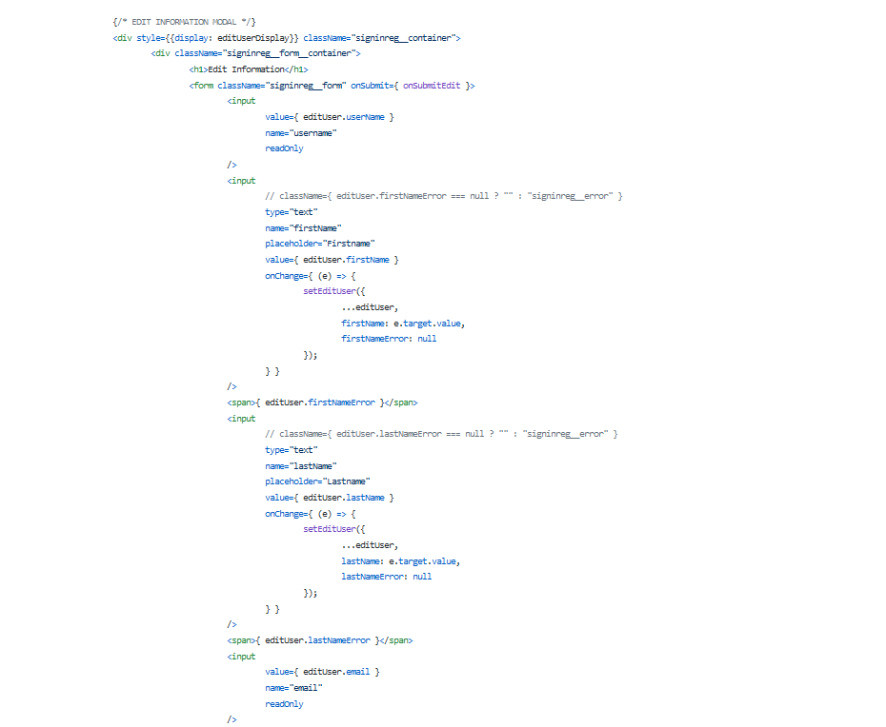
Edit Information Sample Code

Slide 8
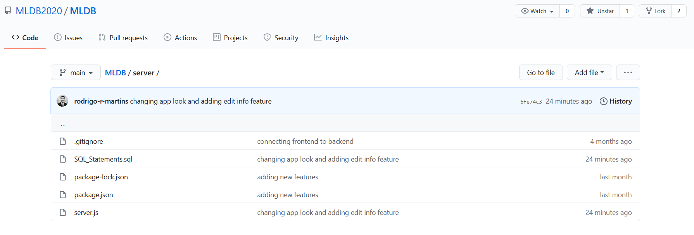
Server folder

Slide 9
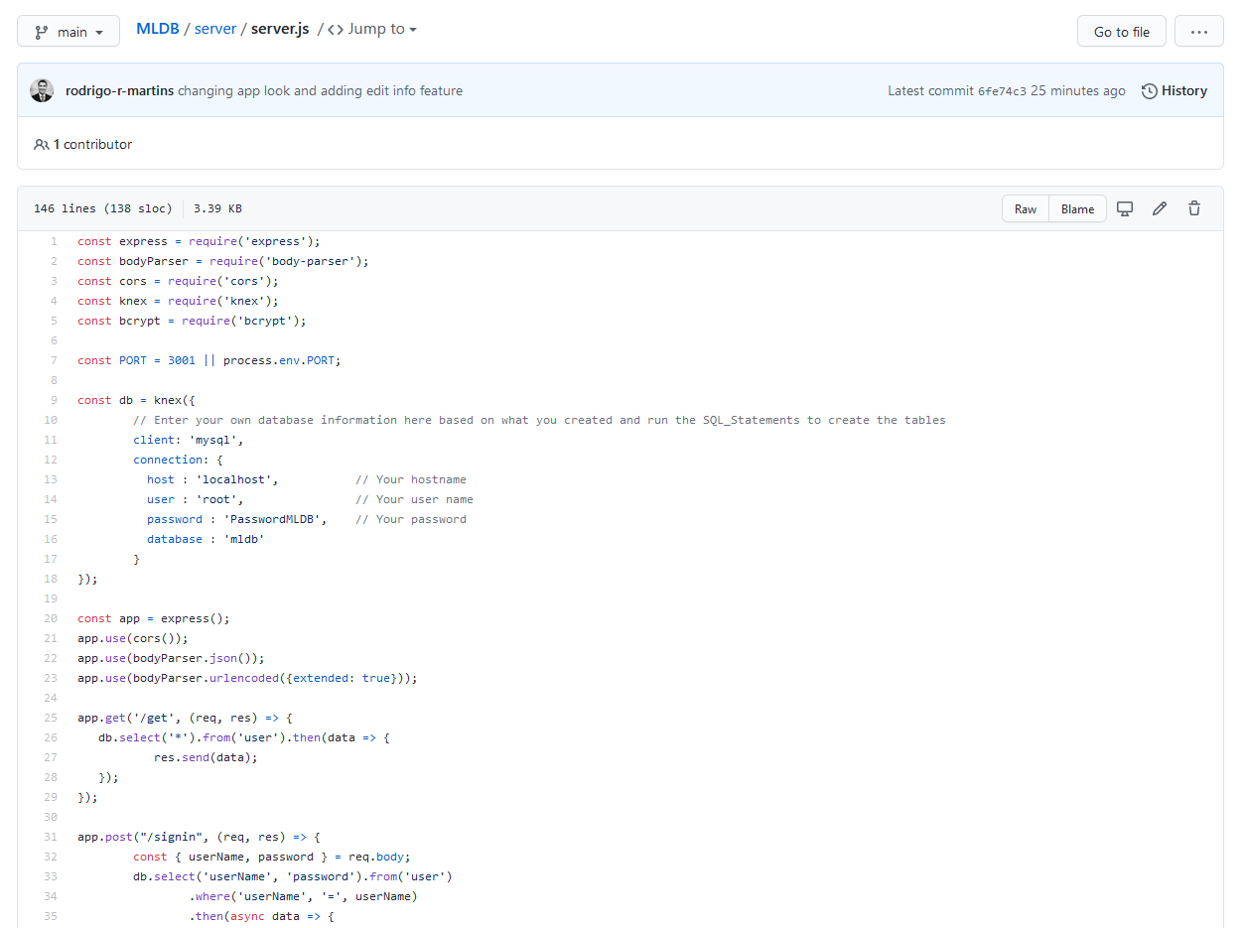
Server – Code Overview

Slide 10
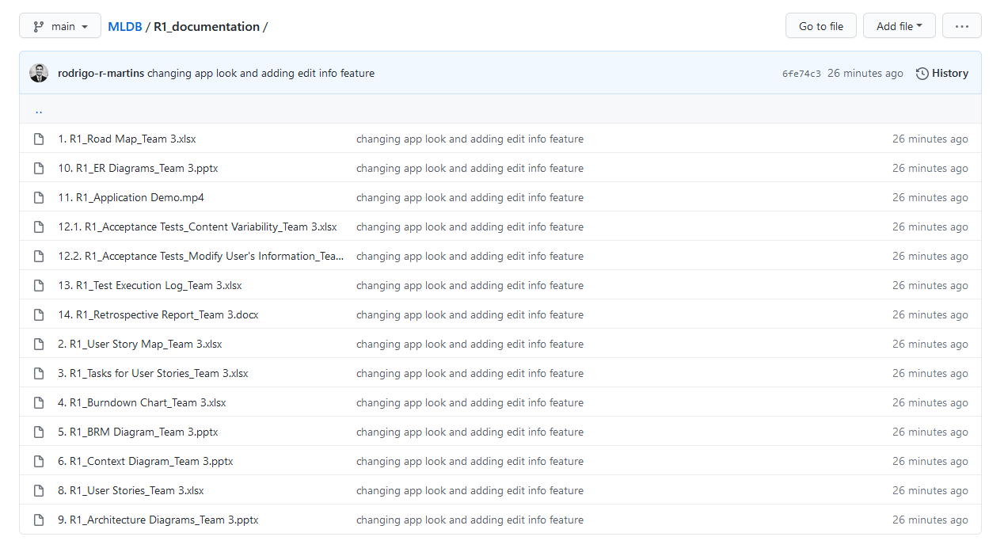
R1 Documentation

